Slide 1
Join Tables
By MAJ15

Slide 2
Membuat table dengan Foreign Key
CREATE TABLE gaji (
gaji_id VARCHAR(10) PRIMARY KEY,
karyawan_id VARCHAR(10),
gaji_pokok DOUBLE,
FOREIGN KEY (karyawan_id) REFERENCES karyawan(karyawan_id)
)ENGINE=INNODB;

Slide 3
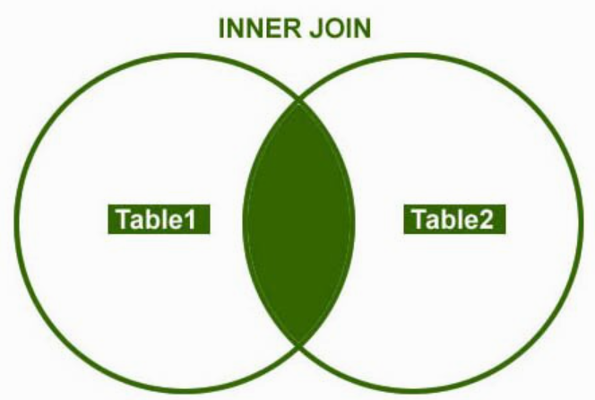
Inner Join
SELECT * FROM karyawan INNER JOIN gaji ON karyawan.karyawan_id=gaji.karyawan_id;

Slide 4
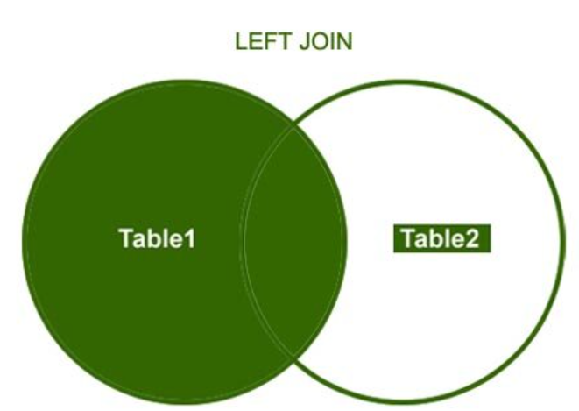
Left Join
SELECT * FROM karyawan LEFT JOIN gaji
ON karyawan.karyawan_id=gaji.karyawan_id;

Slide 5
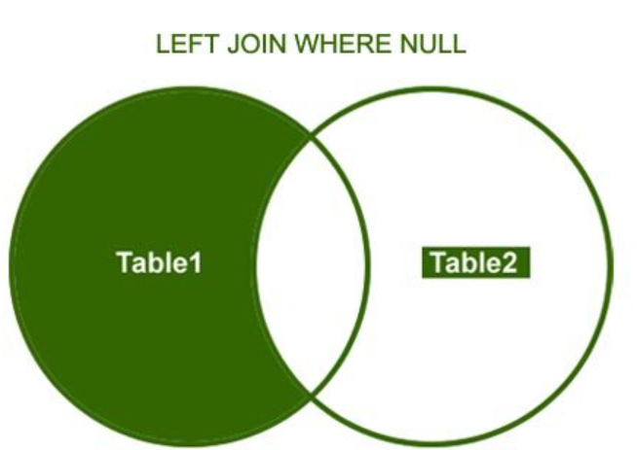
Left Join Where
SELECT * FROM karyawan LEFT JOIN gaji
ON karyawan.karyawan_id=gaji.karyawan_id
WHERE gaji.karyawan_id IS NULL;

Slide 6
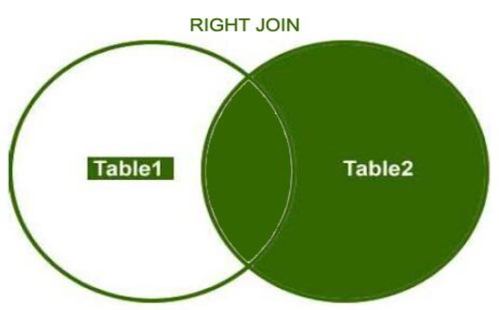
Right Join
SELECT * FROM gaji RIGHT JOIN karyawan ON gaji.karyawan_id=karyawan.karyawan_id;

Slide 7
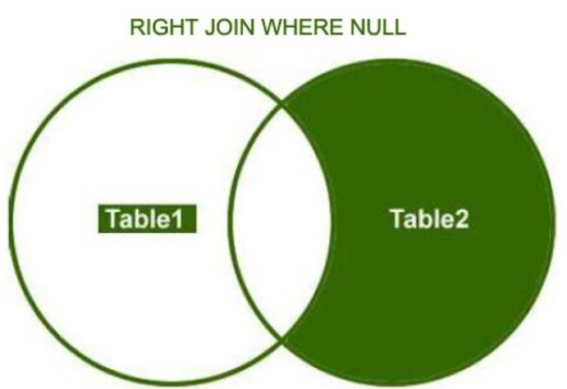
Right Join Where
SELECT * FROM gaji RIGHT JOIN karyawan ON gaji.karyawan_id=karyawan.karyawan_id WHERE gaji.karyawan_id IS NULL;

